Slide 1
NATURAL RESOURCES MANAGEMENT PLAN FOR WHITETAIL WOODS REGIONAL PARK: RECOMMENDATION FOR PLAN ADOPTION
Joe Walton, Senior Ecologist
Tom Lewanski, Natural Resource Manager

Slide 2
VISION FOR NATURAL RESOURCES
The water, vegetation, and wildlife of Dakota County Parks will be managed to conserve biodiversity, restore native habitats, improve public benefits, and achieve resilience and regionally outstanding quality, now and for future generations.
Whitetail Woods Regional Park is a healthy mosaic of natural and community spaces that restore the human spirit, where people can gather, celebrate, and be inspired. Outstanding recreation and learning experiences heighten awareness and appreciation of our relationship with nature.
Notes:
Upper statement is adapted from the NRMSP.
Second statement is from the 2012 WWRP Master Plan.

Slide 3
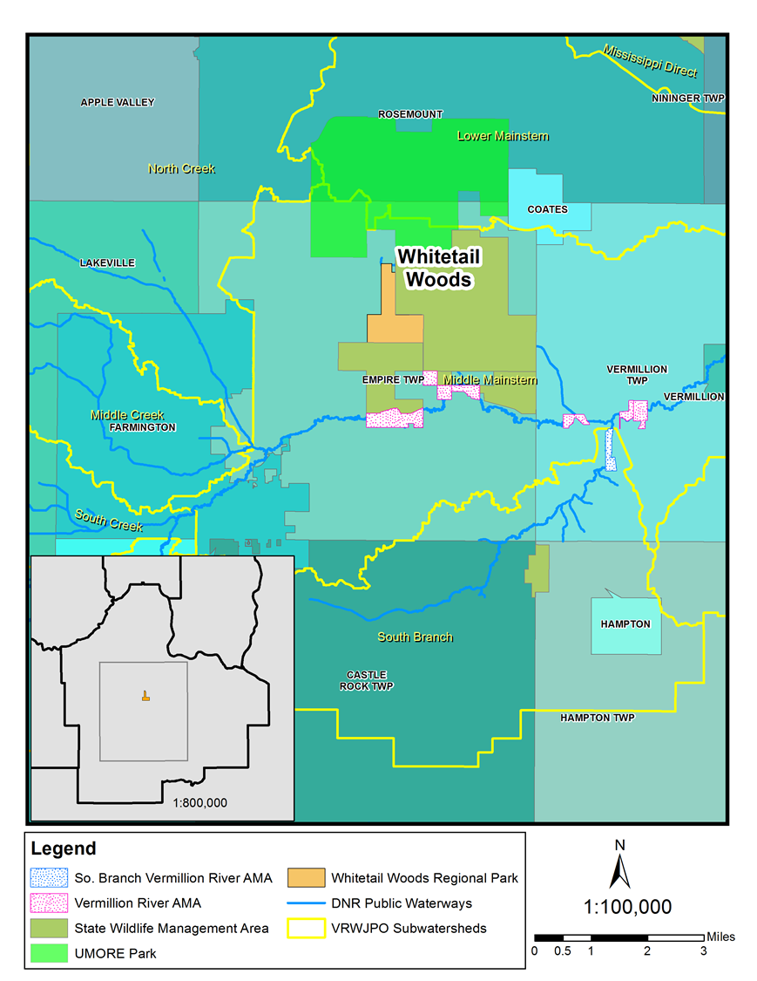
Landscape Context
Notes:
Adjacent Land Use
Private Land, Mining—impacts and recommendations
Private Land, Farming—impacts and recommendations
Buffer for Park
Ditches and Wetland Restoration—effects downstream and upstream

Slide 4
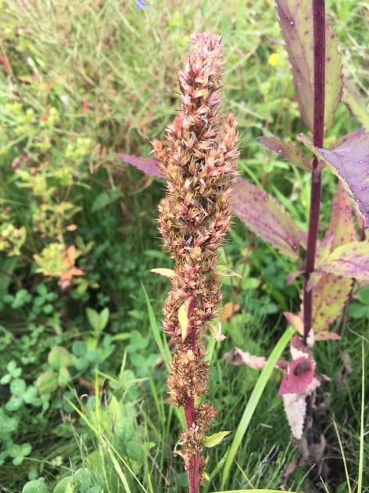
PROJECT RECAP
Research & Findings
Goals
Recommendations
Priorities
Notes:
From previous two updates, 2018 and 2019.

Slide 5
Work Plan Summary with Anticipated Funding
Notes:
Restoration costs are minimal because most of the park has already undergone an initial restoration. Upcoming costs are primarily enhancements and maintenance. Phasing can be adjusted as needed—this is just a suggestion.

Slide 6
Comments from the Public Review Period
Public Review period was conducted from July 15-August 31, 2020
Changes to the document occurred as a result of the comments, and are highlighted in yellow in the draft plan

Slide 7
Comments from the Public Review Period: Open House
An Virtual Open House was held, via Zoom, on Wednesday, August 6, 2020

Slide 8
Comments from the Public Review Period: Open House
Summary of Poll Questions
Attendees were either very or somewhat familiar with the park
Attendees had noticed many or at least a few changes in the park’s natural resources over the past few years
Changes attendees had noticed were felt to be for the better not the worse
Attendees were intrigued by the possibility or introducing wild rice to Empire Lake, but wanted to research it first and consider the consequences

Slide 9
Comments from the Public Review Period: Open House
Summary of Poll Questions
Attendees felt that the direction, vision, and goals of the plan were either just right or very good but needed a little work
Attendees either strongly agreed or agreed with the priorities that were laid out in the plan
Regarding the Work Plan, although some attendees felt that it would take too long to achieve intended results, most felt that it was either what they expected or seemed about right.
There were no further questions at the end of the presentation

Slide 10
Comments from the Public Review Period
Both the Vermillion River Watershed Joint Powers Organization and the Dakota Soil and Water Conservation District reviewed the plan. They made several comments, mostly regarding water resources management. Some of the comments are listed here:
Include the subwatershed analysis in the Work Plan
Could Dakota County look into upstream and provide buffering on private and County properties to slow sedimentation and stormwater runoff?
Due to potential internal loading of Empire Lake, some sediment analysis may be needed to determine phosphorous release rates.

Slide 11
NEXT STEPS
Physical Development Committee, October 13
Plan Adoption, October 20, 2020

Slide 12
NEXT STEPS
Action Requested:
Recommend to the County Board that the draft Natural Resource Management Plan for Whitetail Woods Regional Park be adopted.

Slide 13
QUESTIONS?

